Slide 1
SIT105 - Critical Thinking and Problem Solving for IT Class 07
Part 1 – Building and Checking Algorithms
Part 2 – Selection Statements
Dr. Frank Jiang
Frank.Jiang@deakin.edu.au

Slide 2
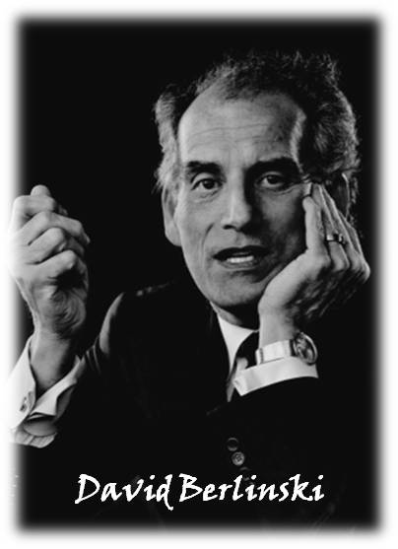
Quote of TODAY
More than sixty years ago, mathematical logicians, defined the concept of an algorithm, and gave content to the ancient human idea of an effective calculation. Their definitions led to the creation of the digital computer.
Quote by: David Berlinski
American philosopher, educator, and author.
Author of the book:
The Advent of the Algorithm: The 300-Year Journey from an Idea to the Computer.

Slide 3

Part 1 Content
Defining Diagram
Algorithm Design
Desk Check

Slide 4


Reminder: What is an Algorithm?
Algorithms have been commonly defined in simple terms as:
"instructions for completing a task"
They've also been called "recipes". In The Social Network movie, an algorithm is what Zuckerberg needed to make Facemash work.
If you saw the movie, you probably remember seeing what looked like a scribbly equation on a window in Mark's dorm room.
These were patterns for completing a specific task in an efficient way!
In this class we will use Pseudocode to write algorithms! This is a high level, structured English approach.

Slide 5


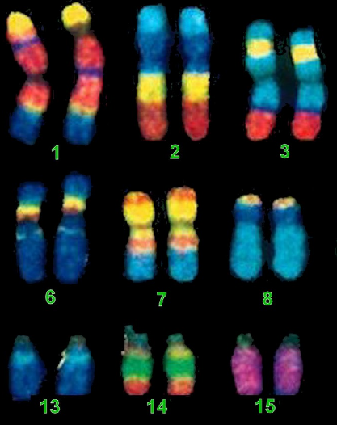
Why Study Algorithms?
They are used everywhere!
Internet. Web search, packet routing, distributed file sharing, ...
Biology. Human genome project, protein folding, …
Computers. Circuit layout, databases, caching, networking, compilers, …
Computer graphics. Movies, video games, virtual reality, …
Security. Cell phones, e-commerce, voting machines, …
Multimedia. MP3, JPG, DivX, HDTV, face recognition, …
Social networks. Recommendations, news feeds, advertisements, …
Physics. N-body simulation, particle collision simulation
Source: Jon Kleinberg And Éva Tardos. Princeton University

Slide 6
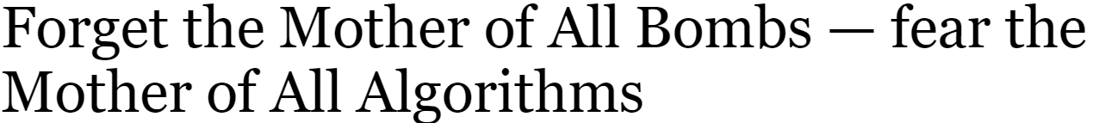
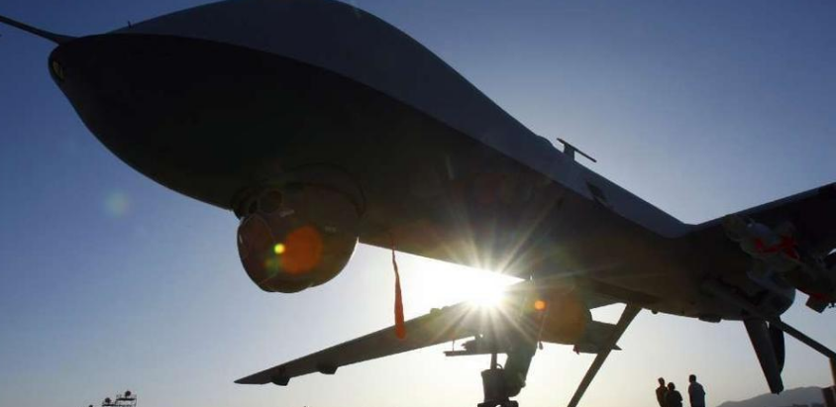
The Mother of All Bombs made news last week after the U.S. military dropped its most powerful non-nuclear bomb at a site in Afghanistan.
The Pentagon has put artificial intelligence at the center of its strategy to maintain the United States’ position as the world’s dominant military power. It is spending billions of dollars to develop what it calls autonomous and semiautonomous weapons and to build an arsenal stocked with the kind of weaponry.
The US Defense Department is designing robotic fighter jets that would fly into combat alongside manned aircraft. It has tested missiles that can decide what to attack, and it has built ships that can hunt for enemy submarines, stalking those it finds over thousands of miles, without any help from humans. ...
Question: If future presidents and Pentagons trusted algorithms to make such decisions regarding conflicts between two nations, is there a chance that war’s could start without human involvement?

Slide 7
Defining Diagrams

Slide 8

Where to begin? Defining the Problem!
We talked last week about the 7 steps to developing a program.
The first step is defining the problem!
Investigate it until you know the requirements
Often we need to find out additional specific information to work out the problem entirely.
To assist with analysis of your problem we can use a defining diagram.
Inputs
Outputs
Processing

Slide 9
Defining Diagram
Kindly, slowly, here, often, and very are examples of adverbs. Adverbs modify verbs, adjectives, or other adverbs.
We identify these from the problem statement:
Inputs (nouns and adjectives)
Outputs (nouns and adjectives)
Processing (verbs and adverbs)
Tabulate them!
Inputs Processing Outputs

Slide 10
Defining Diagram (example - inputs)
Problem statement
A program is required to read three numbers,
add them together, and print their total.
Defining Diagram
Inputs Processing Outputs
3 numbers

Slide 11
Defining Diagram (example - processing)
Problem statement
A program is required to read three numbers,
add them together, and print their total.
Defining Diagram
Inputs Processing Outputs
3 numbers
read 3 numbers
add these numbers
print the total

Slide 12
Defining Diagram (example - outputs)
Problem statement
A program is required to read three numbers,
add them together, and print their total.
Defining Diagram
Inputs Processing Outputs
3 numbers
read 3 numbers
add these numbers
print the total
total

Slide 13
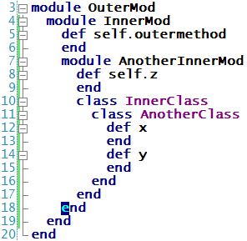
Algorithm Design
the algorithm is based on the Defining Diagram
the algorithm is written in Pseudocode
Template:
Beginning: start the algorithm with its name
Middle: statements; indented for readability
End: finish using the END statement

Slide 14
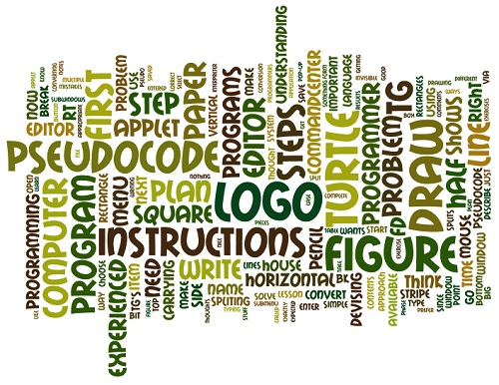
Algorithm Design (example 1)
Algorithm (Version 1)
ADD_THREE_NUMBERS
READ n1
READ n2
READ n3
total = n1 + n2 + n3
PRINT total
END

Slide 15
Algorithm Design (example 2)
Algorithm (Version 2)
ADD_THREE_NUMBERS
READ n1, n2, n3
total = n1 + n2 + n3
PRINT total
END

Slide 16
Algorithm Design (example 3)
Algorithm (Version 3)
ADD_THREE_NUMBERS
READ n1, n2, n3
PRINT n1 + n2 + n3
END
Which version (1, 2 or 3) is “better”?

Slide 17
Algorithm Design (example 3)
Which version (1, 2 or 3) is “better”?
Time? If they are written into computer code. The compiler will turn all 3 oft these examples into the same result, so processing time generally will be the same.
Maintenance? You don’t want to mix up your logical concepts.
In version 3: its doing 2 things, in just 2 lines.
Try to separate them out as much as possible, so its easier to fix bugs.
The first example is best.

Slide 18
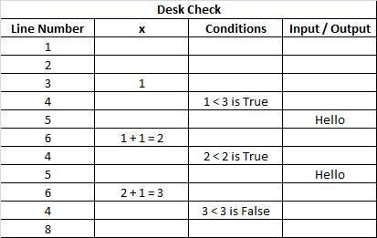
Desk Check
Steps in desk checking!
Choose good test data (valid and invalid)
Determine expected results (without using algorithm)
Tabulate all variable names to record their values
Step through the algorithm one statement at a time and record all actual results in this table
Compare actual results to expected results
If errors detected, fix them and go-to 4

Slide 19
Desk Check (example)
Desk check - for adding 3 numbers
Test ID Test Data Expected Results
1 0 6 15 21
2 -1 4 -2.5 0.5
3 one two three error
4 1 2 three error
5 1 2 3 4 6
6 10 11 program blocked, waiting for input

Slide 20
Desk Check (example) – Algorithm Test
Test 1 data: 0, 6, 15
Compare
expected result (21) equals actual result (21)
statement | n1 | n2 | n3 | total | output
READ | 0
READ | 0 | 6
READ | 0 | 6 | 15
assignment | 0 | 6 | 15 | 21
PRINT | 0 | 6 | 15 | 21 | 21

Slide 21
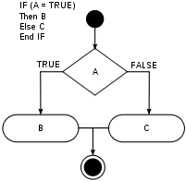
Part 2 Content
Selection Concept
IF Statement
IF … ELSE Statement
Nested IF Statements
CASE Statement
CASE Statement with flexibility

Slide 22
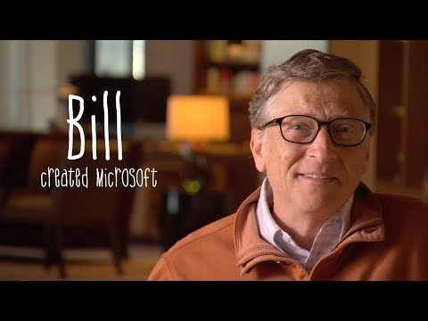
Bill Gates explains If statements! (video)

Slide 23
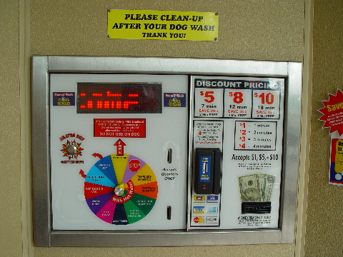
Selection Concept
Selection statements are used to:
select and evaluate one embedded group of statements
and so ignore other embedded groups.
The selection depends on the value of:
an explicit Boolean expression as used in IF statements
an implicit Boolean expression as used in CASE statements
You don’t see the Boolean expression here, its hidden away!
Boolean data type is a data type, having two values (usually denoted true and false)

Slide 24
IF Statement
Format
IF Boolean expression THEN
statements
ENDIF
The value of a Boolean expression is True or False.
The green block is executed after the blue block, but only when the blue block has a TRUE value

Slide 25
IF Statement - Example 1
age = 21
IF age >= 18 THEN
PRINT “voter”
ENDIF
The Age variable is set to 21.
The expression checks if that value is greater than or equal to 18.
If it is then Print out some text to the screen.
Then ends the statement.

Slide 26
IF … ELSE Statement
Format
IF Boolean expression THEN
statement1
ELSE
statement2
ENDIF
The green block is executed after the blue block, but only when the blue block has a TRUE value
The yellow block is executed after the blue block, but only when the blue block has a FALSE value

Slide 27
IF … ELSE Statement - Example 1
age = 15
IF age >= 13 AND age <=19 THEN
PRINT “Teenager.”
ELSE
PRINT “Not a teenager.”
ENDIF
The Age variable is set to 15.
The expression checks if that value is greater than or equal to 13 or less than or equal to 19.
If it is then Print out some text to the screen if it meets those values.
If its not then Prints out some alternative text.
Then ends the statement.

Slide 28
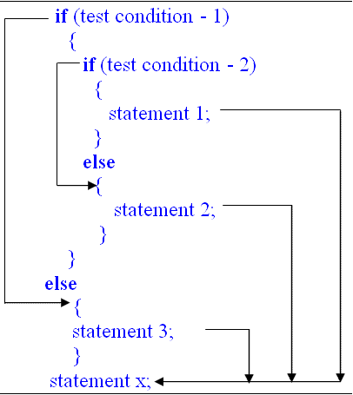
Nested IF Statements
In general, the statements clause of an IF statement can be any kind of statement.
IF Boolean expression THEN
statements
ENDIF
When this statement is another IF statement, it is said to be nested within the outer IF statement.

Slide 29
Nested IF Statements - Example 1
IF Boolean expression1 THEN
IF Boolean expression2 THEN
statement 1
ELSE
statement 2
ENDIF
ENDIF
The nested IF section is in green in the diagram.

Slide 30
Nested IF Statements - Example 2
IF Boolean expression1 THEN
IF Boolean expression2 THEN
IF Boolean expression3 THEN
statement1
ELSE
statement2
ENDIF
ELSE
statement3
ENDIF
ENDIF
Here we have 2 IF statements in total. Each one is dependant on the Boolean result.

Slide 31
Nested IF Statements - Example 3
IF Boolean expression 1 THEN
IF Boolean expression 2 THEN
IF Boolean expression 3 THEN
statement 1
ELSE
statement 2
ENDIF
ELSE
statement 3
ENDIF
ELSE
IF Boolean expression 4 THEN
statement 4
ELSE
statement 5
ENDIF
ENDIF
We can even have IF statements in our ELSE section!

Slide 32
CASE Statement
A CASE statement:
is just a special form of several IF statements!
usually provides more readability than its equivalent IF statements.
Any CASE statement can be easily rewritten using IF statements.
However most IF statement’s can’t be easily rewritten using a CASE statement.

Slide 33
CASE Statement
Working from top to bottom, a block of statements is executed when the value of the variable matches a value.
Format:
CASE variable
value1 : statements_1
value2 : statements_2
value3 : statements_3
...
OTHER : statements_N
ENDCASE
Once a match is found, do not look for additional matches.
For no matches, execute the statements in the OTHER clause.

Slide 34
CASE Statement – Example 1
x = 5
CASE x
0 : PRINT “ZERO”
1 : PRINT “ONE”
10 : PRINT “10, 11 or 12”
11 : PRINT “10, 11 or 12”
12 : PRINT “10, 11 or 12”
OTHER: PRINT “x is not 0, 1, 10, 11 or 12”
ENDCASE

Slide 35
CASE Statement – Example 2
This example is equivalent to the CASE statement in Example 1 but written with nested IF’s
IF x = 0 THEN
PRINT “ZERO”
ELSE
IF x = 1 THEN
PRINT “ONE”
ELSE
IF x >= 10 AND x <= 12
PRINT “10, 11 or 12”
ELSE
PRINT “x is not 0, 1, 10, 11 or 12”
ENDIF
ENDIF
ENDIF

Slide 36
CASE Statement with Flexibility
Cases could be based on ranges or sets, instead of a single value.
Format:
CASE expression
values1 : statements_1
values2 : statements_2
values2 : statements_3
...
OTHER : statements_N
ENDCASE
Example

Slide 37
CASE Statement with Flexibility - Example
Cases could be based on ranges or sets, instead of a single value.
An equation instead of a set value
CASE 2x² + y²
0 : PRINT “ZERO”
1 : PRINT “ONE”
2, 4, 5, 8 : PRINT “2, 4, 5 or 8”
5* : PRINT “Number begins with a 5”
10 to 12 : PRINT “10, 11 or 12”
OTHER : PRINT “an unexpected value”
ENDCASE

Slide 38
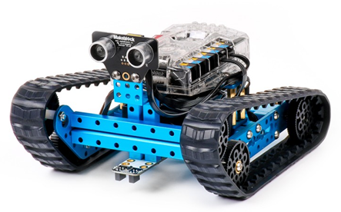
Following on from #1 make me repeat this 3 times! (without copying the code 3 times)
For next week…
Lets try to code Wally with some simple Algorithms!
Using sequential steps make me go around the front of the room in a square formation!

Slide 39
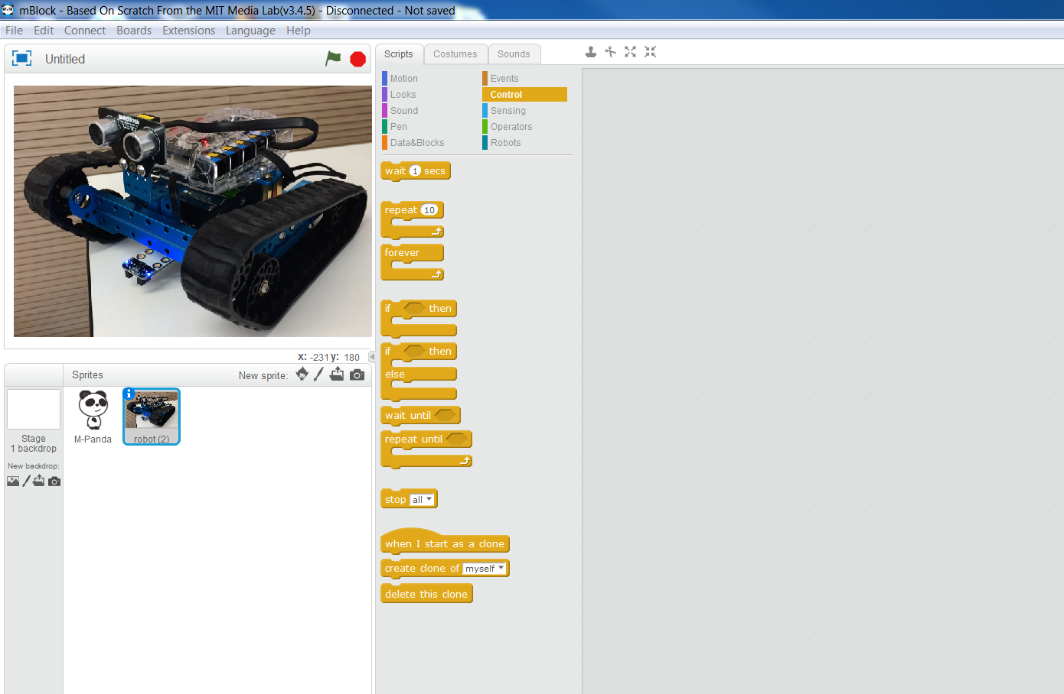
Wally Bot – How to code it? mBlock (Based on Scratch from MIT Media Lab)

Slide 40
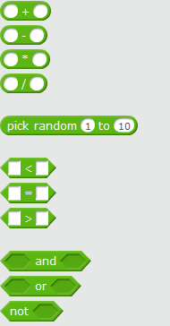
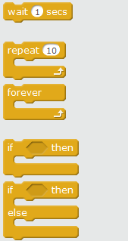
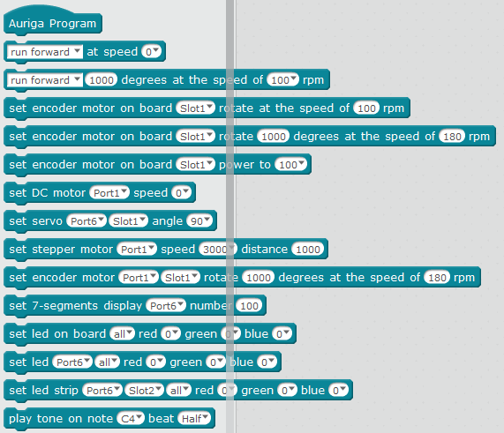
Wally Bot – How to code it?
Operators
Control
Robotic functions

Slide 41
Homework Reading
Extract 13 and Extract 14
Critical Thinking and Problem Solving for IT, 1st Edition compiled by Robert Dew, and published by Cengage Learning.

